Slide 1
NumPy
Ref: https://numpy.org/doc/stable/user/whatisnumpy.html

Slide 2
What is NumPy
NumPy is a library written for scientific computing and data analysis. It stands for numerical python
The most basic object in NumPy is the ndarray, or simply an array which is an n-dimensional, homogeneous array. By homogenous, we mean that all the elements in a NumPy array have to be of the same data type, which is commonly numeric (float or integer)

Slide 3
Advantages of NumPy What is the use of arrays over lists, specifically for data analysis?
You can write vectorised code on NumPy arrays, not on lists, which is convenient to read and write, and concise.
NumPy is much faster than the standard Python ways to do computations.
(Vectorised code typically does not contain explicit looping and indexing etc. (all of this happens behind the scenes, in precompiled C-code), and thus it is much more concise)

Slide 4
Creating NumPy Arrays Different ways of creating NumPy Arrays
Convert lists or tuples to arrays using, np.array() as done above
Initialise arrays of fixed size (when the size is known)
The other common way is to initialise arrays. You do this when you know the size of the array beforehand
np.ones(): Create an array of 1s
np.zeros(): Create an array of 0s
np.random.random(): Create an array of random numbers between 0 and 1
np.arange(): Create an array with increments of a fixed step size
np.linspace(): Create an array of fixed length

Slide 5
More functions….
np.full(): Create a constant array of any number ‘n’
np.tile(): Create a new array — by repeating an existing array — for a particular number of times
np.eye(): Create an identity matrix of any dimension
np.random.randint(): Create a random array of integers within a particular range

Slide 6
Structure and Content of Arrays It is helpful to inspect the structure of NumPy arrays, especially while working with large arrays. Some attributes of NumPy arrays are
shape: Shape of array (n x m)
dtype: data type (int, float etc.)
ndim: Number of dimensions (or axes)
itemsize: Memory used by each array element in bytes

Slide 7
Subset, Slice, Index and Iterate through Arrays
Multidimensional Arrays
Multidimensional arrays are indexed using as many indices as the number of dimensions or axes. For instance, to index a 2-D array, you need two indices - array[x, y]
Each axes has an index starting at 0. The following figure shows the axes and their indices for a 2-D array.

Slide 8
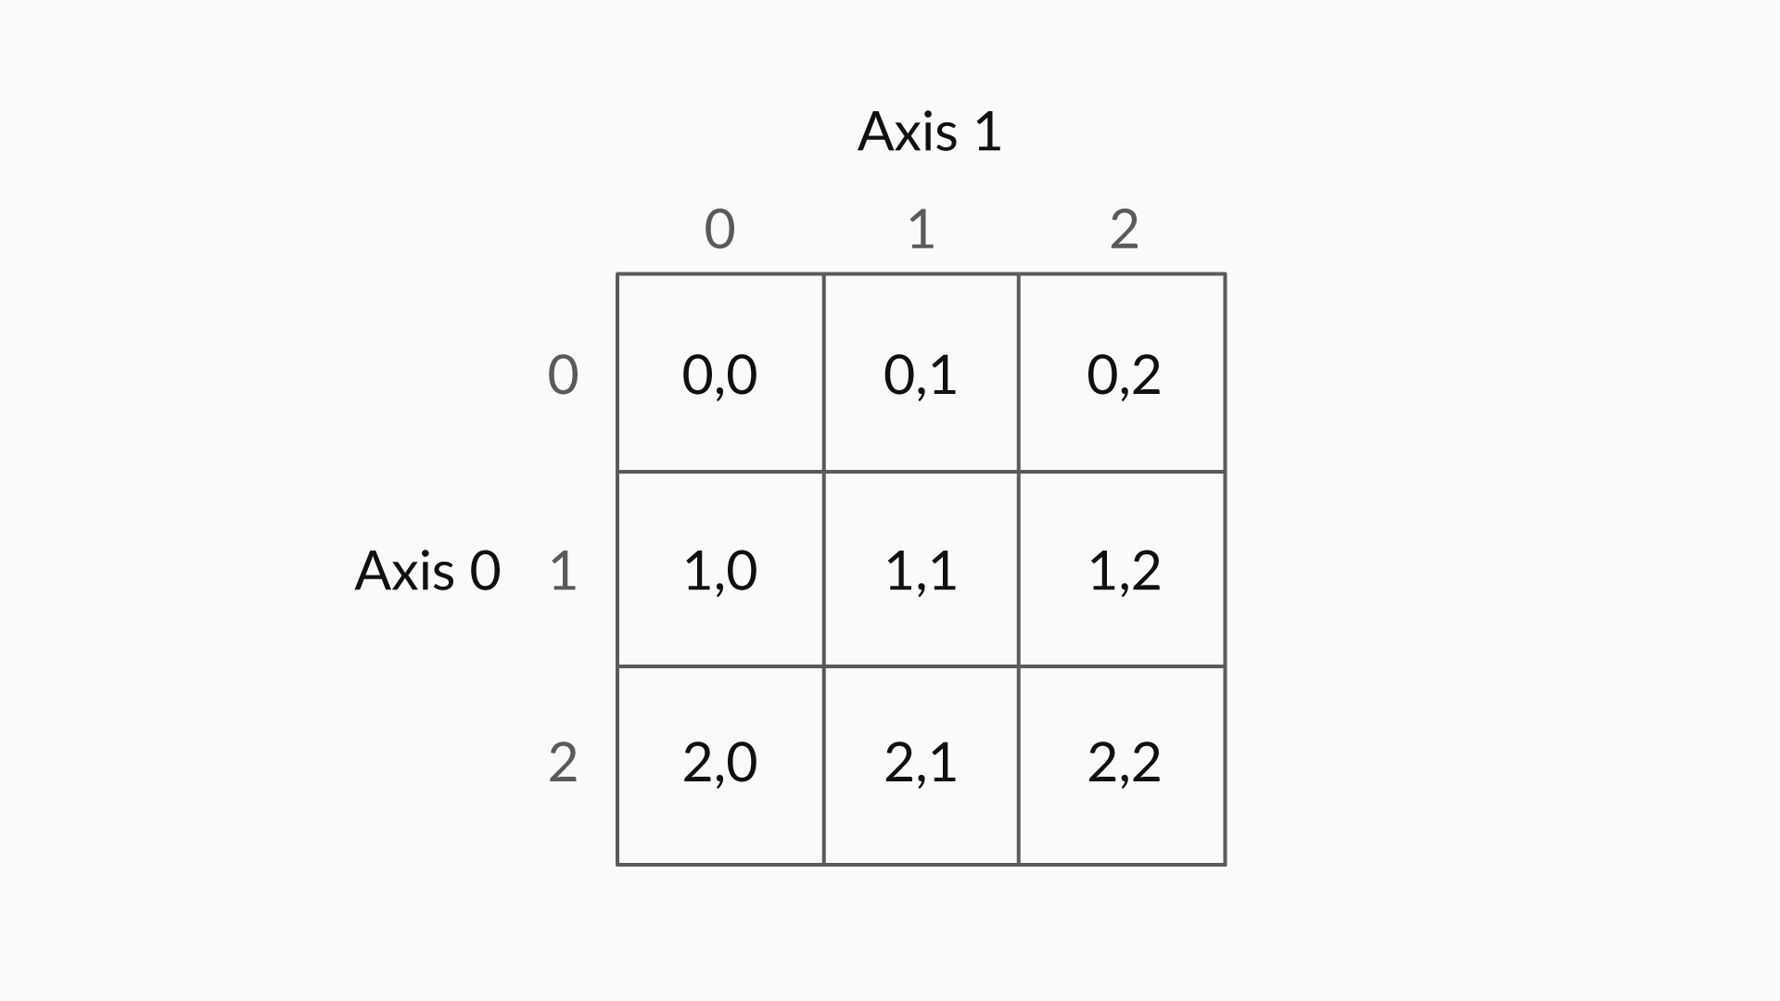
Each axes has an index starting at 0. The following figure shows the axes and their indices for a 2-D array.

Slide 9
Some reasons for such difference in speed are:
NumPy is written in C, which is basically being executed behind the scenes
NumPy arrays are more compact than lists, i.e. they take much lesser storage space than lists

Slide 10
Let us refer the Jupytor Notebook file:
01-NumPy Arrays.ipynb

Slide 11
The various operations that you learnt about are
Arrays which are the basic data structure in NumPy library.
Creating NumPy arrays from a list or a tuple.
Creating randomly large arrays which can be done using the arange command.
Analysing the shape and dimension of an array using array.shape, array.ndim and so on.
Indexing, slicing and subsetting an array which is very similar to indexing in lists.
Working on multidimensional arrays.

